Slide 1
Early implementation of CAM : PRISMA initiative
GRI South – SG Meeting
Madrid, 30 April 2013

Slide 2
19 TSOs already involved in the initiative…
Following TSOs are involved in PRISMA initiative:
Austria: BOG, Gas Connect Austria, TAG
Belgium: Fluxys Belgium
Denmark: Energinet.dk
France: GRTgaz
Germany: Bayernets, Gastransport Nord, Fluxys Tenp, Gascade Gastransport, Gasunie Deutschland Transport Services, GRTgaz Deutschland, Nowega, ONTRAS, Open Grid Europe, terranets bw, Thyssengas
Italy: SNAM Rete Gas
The Netherlands: Gasunie Transport Services
PRISMA is an open cooperation that allows all European TSOs to participate in the cooperation

Slide 3







PRISMA Currently Connects Nine European Hubs
  The platform connects nine European gas hubs in 7 countries
    CEGH
    Gaspool
    NCG
    Nord Pool
    PEG North
    PEG South
    PSV
    TTF
    ZTP
  A pilot with Gaz Systems (Poland) will start in June to sell quarterly capacity
ZTP
PSV
Current PRISMA countries
PRISMA pilot projects

Slide 4
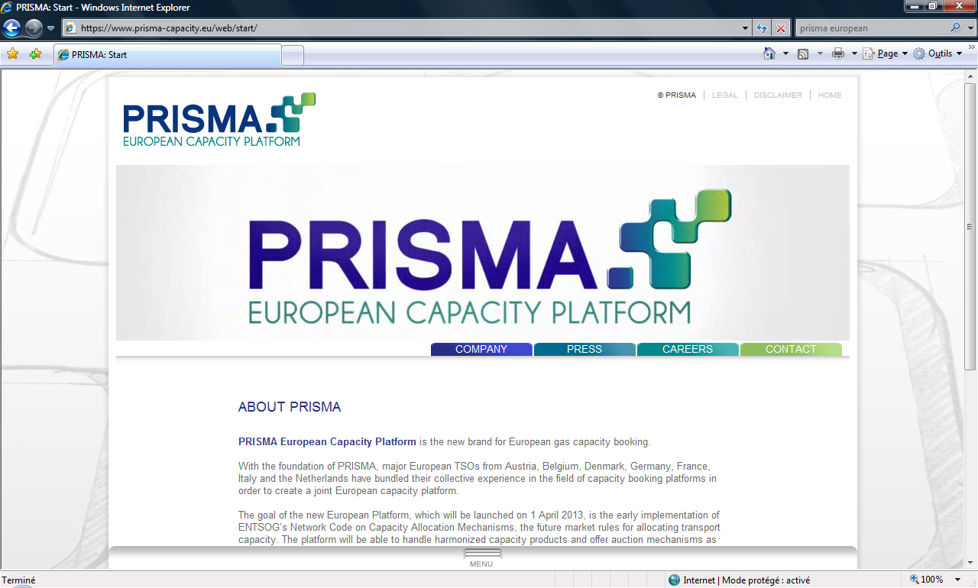
PRISMA is operational since 1st April 2013
General
www.prisma-capacity.eu
Capacity products
  Bundled products between hubs
  Unbundled products
  Products as defined in the CAM Network code
  Firm & Interruptible
Allocation
  Auction mechanism as defined in the CAM NC
    Uniform price auction : day-ahead products
    Ascending clock algorithm : monthly, quarterly and yearly products
All products available on one platform: PRISMA European Capacity Platform
  Regional specificities are also handled

Slide 5
PRISMA is operational since 1st April 2013
Products that will be auctioned via PRISMA from April 2013
In April 2013:
Around 850 auctions / week
Around 1650 GWh/h / week
The Netherlands
  Daily
  Monthly¹⁾
  Quarterly¹⁾
  Yearly¹⁾
Denmark (firm and interruptible)
Daily
Monthly
Quarterly
Yearly
Belgium
Daily
Germany
Daily
Monthly
Quarterly
Yearly
Already 238 shippers
registered!
And more to come in
the next weeks...
France
Daily
Monthly
Austria
Daily
Monthly
Quarterly
Yearly
        Italy (firm and interruptible)
Daily
Both algorithm have
been tested:
Multi-round ascending clock & Uniform price
Please note:
1 – The Netherlands: Auctions of Monthly, Quarterly and Yearly products as of the end of 2013
(according to CAM calendar)

Slide 6
PRISMA is operational since 1st April 2013
Translation of CAM provisions in national regulations has been needed
Country
Necessary adaptations in national regulations
Austria
Belgium
Denmark
France
Germany
Austrian regulation foresees auctions of capacities as from April 1st 2013
Adaptations of standard transmission agreement, access code for transmission and transmission program
Adaptations submitted into consultation in Jan-Feb – Documents submitted to CREG approval
CAM auctions as allocation method approved by DERA in September 2012
CRE decision authorising auctions on PRISMA platform for products as of April 2013
No need for adaption in German regulatory framework which already allows for capacity to be auctioned
Nevertheless, some changes of how auctions will be carried out as of 1st April have been announced by German TSOs in a “Platform concept paper”
Italy
The Netherlands
Joint Guidelines for DA product allocation at Tarvisio and applicable tariffs for firm and interruptible capacity have been published by the NRA
SRG Network Code updates approved on 28.03.2013
GTS has applied for exemption to offer bundled auctions as of 1 April 2013. After 3 weeks consultation period a positive decision of the NMa has been taken end of March. For the full implementation of CAM & CMP GTS and NMa are working on a code adaptation process. To be finalized end of 2013.

Slide 7

PRISMA is operational since 1st April 2013
Contractual landscape established
General Terms & Conditions formalise relations between shippers and PRISMA
Close collaboration NRAs/TSOs when drafting the General Terms & Conditions
PRISMA
GTCs
Service contract
National regulatory documents
TSOs
Network users

Slide 8
PRISMA is willing to be customer oriented
PRISMA is based on the existing return on experience of Capsquare, Trac-X and Link4hubs
During the implementation phase, a broad communication has been given to the Market to give feedbacks on the objectives and the timelines
  8 meetings in South and North-West and South-South-East Gas Regional Initiatives (IG and SG meetings) since March 2012
  Several shippers’ meetings have been organized in Belgium, Vienna and Warsaw in February 2013; TSOs have also organized meetings in Milano and Paris
  (> 300 participants)

Slide 9
Conclusion
Already a successful project
PRISMA had the target to be ready to sell capacity products as of April 1st 2013
  This target has been reached!
According to the conclusions of the last Madrid Forum, the Forum welcomes implementation initiatives such as ENTSOG's and ACER's work on an implementation Roadmap, including PRISMA and other booking platforms, and encourages ACER and ENTSOG to continue the work in close cooperation with the relevant stakeholders by e.g. collecting and documenting common problems and best practices to enable efficient solutions. The Forum invites ACER and ENTSOG to promote the convergence of the on-going projects to avoid duplication of costs, as well as to report on progress of implementation at its next sessions.
An update on the countries implementing PRISMA could be presented at next GRI meetings

